Slide 1
Programming Shared Address Space Platforms
Ananth Grama, Anshul Gupta, George Karypis, and Vipin Kumar
To accompany the text ``Introduction to Parallel Computing'', Addison Wesley, 2003.

Slide 2
OpenMP: a Standard for Directive Based Parallel Programming
OpenMP is a directive-based API that can be used with FORTRAN, C, and C++ for programming shared address space machines.
OpenMP directives provide support for concurrency, synchronization, and data handling while obviating the need for explicitly setting up mutexes, condition variables, data scope, and initialization.

Slide 3
OpenMP Programming Model
OpenMP directives in C and C++ are based on the #pragma compiler directives.
A directive consists of a directive name followed by clauses.
  #pragma omp directive [clause list]
OpenMP programs execute serially until they encounter the parallel directive, which creates a group of threads.
  #pragma omp parallel [clause list]
  /* structured block */
The main thread that encounters the parallel directive becomes the master of this group of threads and is assigned the thread id 0 within the group.

Slide 4
OpenMP Programming Model
The clause list is used to specify conditional parallelization, number of threads, and data handling.
  Conditional Parallelization: The clause if (scalar expression) determines whether the parallel construct results in creation of threads.
  Degree of Concurrency: The clause num_threads(integer expression) specifies the number of threads that are created.
  Data Handling: The clause private (variable list) indicates variables local to each thread. The clause firstprivate (variable list) is similar to the private, except values of variables are initialized to corresponding values before the parallel directive. The clause shared (variable list) indicates that variables are shared across all the threads.

Slide 5
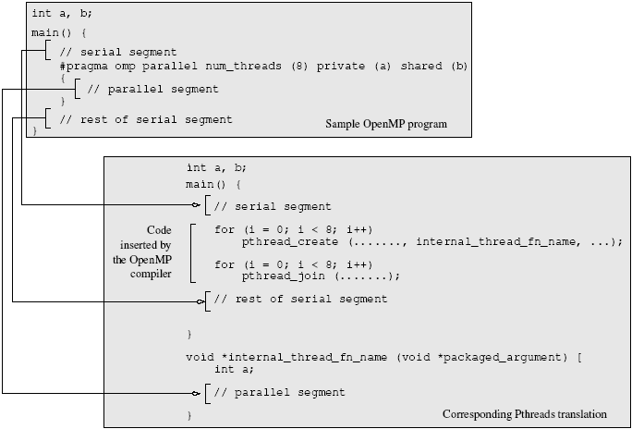
OpenMP Programming Model
A sample OpenMP program along with its Pthreads translation that might be performed by an OpenMP compiler.

Slide 6
OpenMP Programming Model
  #pragma omp parallel if (is_parallel== 1) num_threads(8) \
  private (a) shared (b) firstprivate(c) {
  /* structured block */
  }
If the value of the variable is_parallel equals one, eight threads are created.
Each of these threads gets private copies of variables a and c, and shares a single value of variable b.
The value of each copy of c is initialized to the value of c before the parallel directive.
The default state of a variable is specified by the clause default (shared) or default (none).

Slide 7
Reduction Clause in OpenMP
The reduction clause specifies how multiple local copies of a variable at different threads are combined into a single copy at the master when threads exit.
The usage of the reduction clause is reduction (operator: variable list).
The variables in the list are implicitly specified as being private to threads.
The operator can be one of +, *, -, &, |, ^, &&, and ||.
#pragma omp parallel reduction(+: sum) num_threads(8) {
/* compute local sums here */
}
/*sum here contains sum of all local instances of sums */

Slide 8
OpenMP Programming: Example
/* ******************************************************
An OpenMP version of a threaded program to compute PI.
****************************************************** */
#pragma omp parallel default(private) shared (npoints) \
  reduction(+: sum) num_threads(8)
{
  num_threads = omp_get_num_threads();
  sample_points_per_thread = npoints / num_threads;
  sum = 0;
  for (i = 0; i < sample_points_per_thread; i++) {
    rand_no_x =(double)(rand_r(&seed))/(double)((2<<14)-1);
    rand_no_y =(double)(rand_r(&seed))/(double)((2<<14)-1);
    if (((rand_no_x - 0.5) * (rand_no_x - 0.5) +
      (rand_no_y - 0.5) * (rand_no_y - 0.5)) < 0.25)
      sum ++;
  }
}
Notes:
Our first OpenMP example follows from Example 7.2, which presented a Pthreads program for the same problem. The parallel directive specifies that all variables except npoints, the total number of random points in two dimensions across all threads, are local. Furthermore, the directive specifies that there are eight threads, and the value of sum after all threads complete execution is the sum of local values at each thread. The function omp_get_num_threads is used to determine the total number of threads As in Example 7.2, a for loop generates the required number of random points (in two dimensions) and determines how many of them are within the prescribed circle of unit diameter.

Slide 9
Specifying Concurrent Tasks in OpenMP
The parallel directive can be used in conjunction with other directives to specify concurrency across iterations and tasks.
OpenMP provides two directives - for and sections - to specify concurrent iterations and tasks.
The for directive is used to split parallel iteration spaces across threads. The general form of a for directive is as follows:
  #pragma omp for [clause list]
    /* for loop */
The clauses that can be used in this context are: private, firstprivate, lastprivate, reduction, schedule, nowait, and ordered.

Slide 10
Specifying Concurrent Tasks in OpenMP: Example
#pragma omp parallel default(private) shared (npoints) \
  reduction(+: sum) num_threads(8)
{
  sum = 0;
  #pragma omp for
  for (i = 0; i < npoints; i++) {
    rand_no_x =(double)(rand_r(&seed))/(double)((2<<14)-1);
    rand_no_y =(double)(rand_r(&seed))/(double)((2<<14)-1);
    if (((rand_no_x - 0.5) * (rand_no_x - 0.5) +
      (rand_no_y - 0.5) * (rand_no_y - 0.5)) < 0.25)
      sum ++;
  }
}

Slide 11
Assigning Iterations to Threads
The schedule clause of the for directive deals with the assignment of iterations to threads.
The general form of the schedule directive is schedule(scheduling_class[, parameter]).
OpenMP supports four scheduling classes: static, dynamic, guided, and runtime.

Slide 12
Assigning Iterations to Threads: Example
/* static scheduling of matrix multiplication loops */
#pragma omp parallel default(private) shared (a, b, c, dim) \
  num_threads(4)
  #pragma omp for schedule(static)
  for (i = 0; i < dim; i++) {
    for (j = 0; j < dim; j++) {
      c(i,j) = 0;
      for (k = 0; k < dim; k++) {
        c(i,j) += a(i, k) * b(k, j);
      }
    }
  }

Slide 13
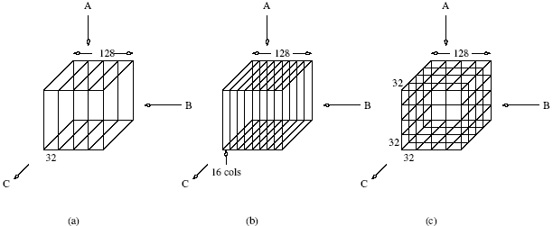
Assigning Iterations to Threads: Example
Three different schedules using the static scheduling class of OpenMP.

Slide 14
Parallel For Loops
Often, it is desirable to have a sequence of for-directives within a parallel construct that do not execute an implicit barrier at the end of each for directive.
OpenMP provides a clause - nowait, which can be used with a for directive.
For visual explanation :http://ppc.cs.aalto.fi/ch3/nowait/

Slide 15
Parallel For Loops: Example
#pragma omp parallel
{
  #pragma omp for nowait
    for (i = 0; i < nmax; i++)
      if (isEqual(name, current_list[i])
        processCurrentName(name);
  #pragma omp for
    for (i = 0; i < mmax; i++)
      if (isEqual(name, past_list[i])
        processPastName(name);
}

Slide 16
The sections Directive
OpenMP supports non-iterative parallel task assignment using the sections directive.
The general form of the sections directive is as follows:
#pragma omp sections [clause list]
{
  [#pragma omp section
    /* structured block */
  ]
  [#pragma omp section
    /* structured block */
  ]
  ...
}

Slide 17
The sections Directive: Example
#pragma omp parallel
{
  #pragma omp sections
  {
    #pragma omp section
    {
      taskA();
    }
    #pragma omp section
    {
      taskB();
    }
    #pragma omp section
    {
      taskC();
    }
  }
}

Slide 18
Nesting parallel Directives
Nested parallelism can be enabled using the OMP_NESTED environment variable.
If the OMP_NESTED environment variable is set to TRUE, nested parallelism is enabled.
In this case, each parallel directive creates a new team of threads.

Slide 19
Merging Directives
In our discussion thus far, we use the directive parallel to create concurrent threads, and for and sections to farm out work to threads. If there was no parallel directive specified, the for and sections directives would execute serially (all work is farmed to a single thread, the master thread). Consequently, for and sections directives are generally preceded by the parallel directive. OpenMP allows the programmer to merge the parallel directives to parallel for and parallel sections, respectively. The clause list for the merged directive can be from the clause lists of either the parallel or for / sections directives.

Slide 20
Example
For example:
1 #pragma omp parallel default (private) shared (n)
2 {
3 #pragma omp for
4 for (i = 0 < i < n; i++) {
5 /* body of parallel for loop */
6 }
7 }
is identical to:
1 #pragma omp parallel for default (private) shared (n)
2 {
3 for (i = 0 < i < n; i++) {
4 /* body of parallel for loop */
5 }
6 }
7
and:
1 #pragma omp parallel
2 {
3 #pragma omp sections

Slide 21
Synchronization Constructs in OpenMP
OpenMP provides a variety of synchronization constructs:
  #pragma omp barrier
  #pragma omp single [clause list]
    structured block
  #pragma omp master
    structured block
  #pragma omp critical [(name)]
    structured block
  #pragma omp ordered
    structured block

Slide 22
OpenMP Library Functions
In addition to directives, OpenMP also supports a number of functions that allow a programmer to control the execution of threaded programs.
  /* thread and processor count */
  void omp_set_num_threads (int num_threads);
  int omp_get_num_threads ();
  int omp_get_max_threads ();
  int omp_get_thread_num ();
  int omp_get_num_procs ();
  int omp_in_parallel();

Slide 23
OpenMP Library Functions
  /* controlling and monitoring thread creation */
  void omp_set_dynamic (int dynamic_threads);
  int omp_get_dynamic ();
  void omp_set_nested (int nested);
  int omp_get_nested ();
  /* mutual exclusion */
  void omp_init_lock (omp_lock_t *lock);
  void omp_destroy_lock (omp_lock_t *lock);
  void omp_set_lock (omp_lock_t *lock);
  void omp_unset_lock (omp_lock_t *lock);
  int omp_test_lock (omp_lock_t *lock);
In addition, all lock routines also have a nested lock counterpart
for recursive mutexes.

Slide 24
Environment Variables in OpenMP
OMP_NUM_THREADS: This environment variable specifies the default number of threads created upon entering a parallel region.
OMP_SET_DYNAMIC: Determines if the number of threads can be dynamically changed.
OMP_NESTED: Turns on nested parallelism.
OMP_SCHEDULE: Scheduling of for-loops if the clause specifies runtime

Slide 25
Explicit Threads versus Directive Based Programming
Directives layered on top of threads facilitate a variety of thread-related tasks.
A programmer is rid of the tasks of initializing attributes objects, setting up arguments to threads, partitioning iteration spaces, etc.
There are some drawbacks to using directives as well.
An artifact of explicit threading is that data exchange is more apparent. This helps in alleviating some of the overheads from data movement, false sharing, and contention.
Explicit threading also provides a richer API in the form of condition waits, locks of different types, and increased flexibility for building composite synchronization operations.
Finally, since explicit threading is used more widely than OpenMP, tools and support for Pthreads programs are easier to find.

